Slide 1
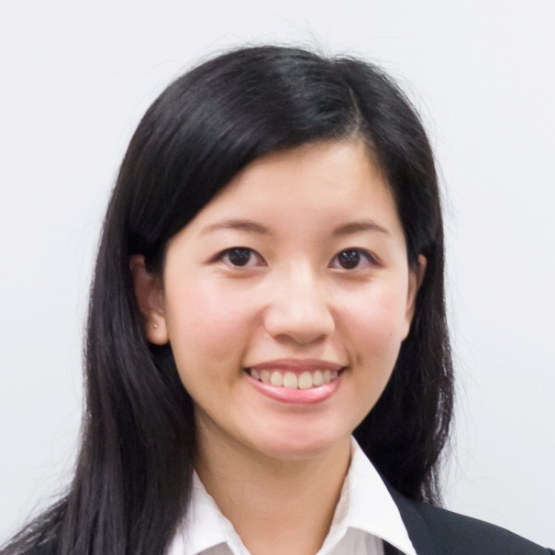
新產品焦點 Hottest New Products
Siny Chan
產品拓展主任－健康與營養 Product Officer – Health & Nutrition

Slide 2
新產品焦點
Hottest New Products
此演講的內容並未受美國食品及藥物管理局評核。此產品並非作為診斷、醫療或預防任何疾病或狀況之用途。
The statements contained in this presentation have not been evaluated by the Food and Drug Administration. This product is not intended to diagnose, treat, cure or prevent any disease.

Slide 3
Isotonix® 健將配方
CHAMPION BLEND
plus

Slide 4
Isotonix® 健將配方
CHAMPION BLEND
plus
表現 – 速溶支鏈氨基酸保留肌肉，有助提升運動表現
防禦 – 強效抗氧化物碧容健®有助對抗自由基
能量 – 多種活性維他命B可更快被人體利用，因而提升效用
Performance – Instantized Branch Chain Amino Acids promote muscle retention and help benefit the performance of active adults
Defense – Antioxidant Pycnogenol® helps combat free radicals
Energy – Activated B vitamins are more readily processed by the body and thereby increase their effectiveness
集表現、防禦、能量於一身 – 健將之選
Performance, Defense, Energy –
the perfect recipe of champions

Slide 5
潔衣新世代 Next Generation of Laundry Care
至2015年，全球工業用酵素的市場金額將以6.6%的複合年均增長率達至15億美元
The global technical enzymes market will increase at a 6.6% compound annual growth rate (CAGR) to reach $1.5 billion in 2015
資料來源Source: “Technology Prospecting on Enzyme: Application, Marketing and Engineering”, Computational And Structural Biotechnology Journal
Notes:
http://journals.sfu.ca/rncsb/index.php/csbj/article/view/csbj.201209017/160
The beauty and charming of enzyme uses in industrial biotechnology are again and again exemplified. Aggregate demand for enzymes in the global market is projected to rise at a fast pace in recent years. Carbonhydrases will remain the leading enzymes in the next few years. While strong growth in the product category will be led by several markets, including food and beverage, animal feed and detergent industry.

Slide 6
工業用酵素的好處 Technical Enzymes Benefits
蛋白酵素 Protease
澱粉液化酵素Alpha-amylase
脂質酵素Lipase

Slide 7
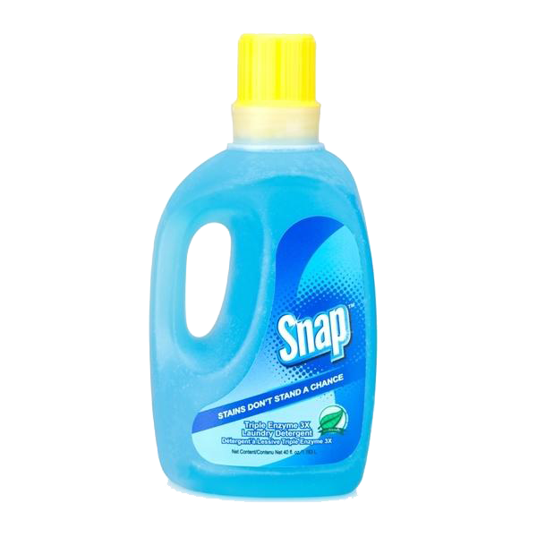
Snap 三重酵素高效洗衣液 Snap Triple Enzyme 3X Laundry Detergent
三重酵素強效抗污 Triple Enzyme Stain-fighting Power
環保 Environmentally-friendly
三倍高濃縮配方 3x Concentrated

Slide 8
Snap 三重酵素高效洗衣液 Snap Triple Enzyme 3X Laundry Detergent
HK6201
DC: $87.0
SR: $122.0
BV: 7.00

Slide 9
Snap 三重酵素高效洗衣液市場比較 Snap Triple Enzyme 3X Laundry Detergent Product Comparison
產品 Products | 不含磷酸鹽 Phosphate-free | 濃縮配方 Concentrated Formula | 三重酵素配方 Triple Enzyme Formula | 每使用份量 零售價 Price per Wash
SNAP洗衣液 SNAP Detergent |  |  |  | $1.52
獅王潔白物語潔衣液 LION Top Fine Fabric Detergent |  |  |  | $1.97
潔霸淨柔超濃縮洗衣液 KAO ATTACK LIO Softener-in Conc |  |  |  | $0.60
安利SA8超濃縮洗衣液 Amway Detergent |  |  |  | $1.84
ECOS®無添加濃縮 洗衣液 Liquid Laundry Detergent |  |  |  | $2.57

Slide 10
2013 新產品
New PRODUCTS
Prime™蝦紅素－健心明目配方 Prime™ Astaxanthin Cardio & Visual Vitality Formula
首次推出品牌系列！
A BRAND NEW LINE!

Slide 11
健康風險 Health Risks
60.4%
82%
的人體能活動量不足 of people lack physical activity
的人每日 進食蔬果不足 of people do not intake sufficient vegetable and fruits on a daily basis
資料來源Source: 香港特別行政區政府衛生署衛生防護中心Centre for Health Protection, Department of Health ,The Government of the Hong Kong Special Administrative Region
Notes:
http://www.chp.gov.hk/tc/data/1/10/280/1338.html
http://www.dh.gov.hk/tc_chi/statistics/statistics_hs/files/Health_Statistics_pamphlet_TC.pdf
世界衞生組織建議: 18-64歲成年人應每週進行最少150分鐘中等強度的帶氧體能活動，或最少75分鐘劇烈強度的帶氧體能活動，或相等於混合兩種活動模式的時間。
於二零一二年四月年齡介乎 至 歲之間人士的選定健康
風險

Slide 12
Prime™蝦紅素 – 健心明目配方 Prime™ Astaxanthin – Cardio and Visual Vitality Formula
AstaREAL®蝦紅素
支援心血管健康
促進視力健康
提供強效抗氧化防護
促進肌膚健康
支援肌肉耐力與表現
Supports cardiovascular health
Promotes healthy vision
Provides powerful antioxidant defense
Promotes healthy skin
Supports muscle endurance and performance

Slide 14
Prime™蝦紅素 – 健心明目配方 Prime™ Astaxanthin – Cardio and Visual Vitality Formula
HK14500
DC: $237.0
SR: $332.0
BV: 23.00

Slide 15
Prime™蝦紅素 – 健心明目配方市場比較 Prime™ Astaxanthin – Cardio and Visual Vitality Formula Product Comparison
產品 Products | 每使用份量 蝦紅素含量 Amount of Astaxanthin per serving | AstaREAL® | 食用份量/零售價 Servings / Price | 每食用份量 零售價 Price per Serving
Prime蝦紅素 健心明目配方 Prime Astaxanthin Cardio and Visual Vitality Formula | 6 |  | 30/ $332.0 | $11.1
Fancl-蝦青素Astaxanthin | 6 |  | 30/ $389.0 | $13.0
Puritan's Pride- Astxanthin | 5 |  | 60/ $214.4 | $3.6
Futurebiotics- Astaxanthin | 4 |  | 30/ $140.0 | $4.7
Doctor's Best- Best Astaxanthin | 3 |  | 30/ $202.7 | $6.8
Source Naturals- Astaxanthin | 2 |  | 60/ $148.0 | $2.5

Slide 16
2013 新產品
New PRODUCTS
最新趨勢：健康飲品 Functional Drinks Go Mainstream

Slide 17
健康飲品類別 Health & Wellness Drink Category
$2,740億美元 - 2011年全球健康飲品的總零售額。至2016年，健康飲品的零售增長將會超越非酒精類飲品
USD$274 billion: Retail value of health and wellness beverages, globally, in 2011. Growth of health and wellness beverages is set to outperform the wider soft and hot drinks industry through 2016.
資料來源 Source: Euromonitor International,
“Health and Wellness Beverages Outperform Wider Drinks Industry”, February 2013
30% - 至2017年，針對心血管健康的食品與飲料的預期銷售增長比率
30%: expected sales increase, globally, of cardiovascular health prime positioned foods and beverages through 2017.
資料來源 Source: Euromonitor International,
“Cardiovascular Health Positioned Products Remain Dynamic”, March 2013
Notes:
http://blog.euromonitor.com/2013/02/health-and-wellness-beverages-outperform-wider-drinks-industry.html
Global retail value of health and wellness beverages reached US$274 billion in 2011, equating to 44% of retail value sales of non-alcoholic beverages. As consumer confidence restores, value demand for health-positioned drinks is returning and growth of health and wellness beverages is set to outperform the wider soft and hot drinks industry over 2012-2016.
Low Calorie, Natural and Functionality Drive Innovation Consumers tend to look for a low calorie content from healthy beverages, due to growing concerns about rising obesity levels. But the demand for healthy beverages is moving away from purely low-calorie variants to those which, whilst low-calorie, also offer added health benefits through either a high proportion of natural ingredients, such as stevia or superfruit juice or added functionality. Drinks positioned at particular health concerns such as cardiovascular health or digestive health are therefore becoming more common across the globe.
To find out more about what is driving global interest in healthy beverages check out the latest Health and Wellness global briefing titled: Functionality, Naturalness and Stevia Key to Developing Beverages to Fit Today’s Trends.
See more at: http://blog.euromonitor.com/2013/02/health-and-wellness-beverages-outperform-wider-drinks-industry.html#sthash.4mFVPXUa.dpuf
http://www.nutraceuticalsworld.com/contents/view_features/2011-11-01/the-cardiovascular-health-market/
http://www.dh.gov.hk/tc_chi/statistics/statistics_hs/files/Health_Statistics_pamphlet_TC.pdf hong kong’s situation

Slide 18
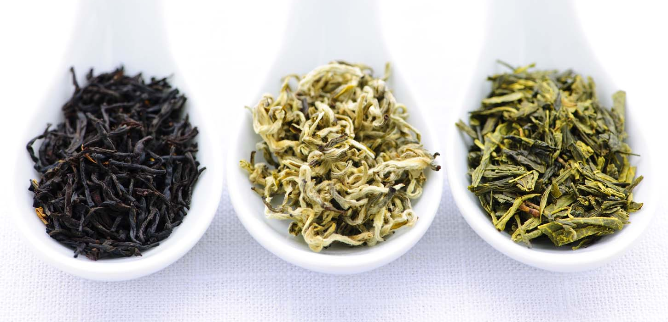
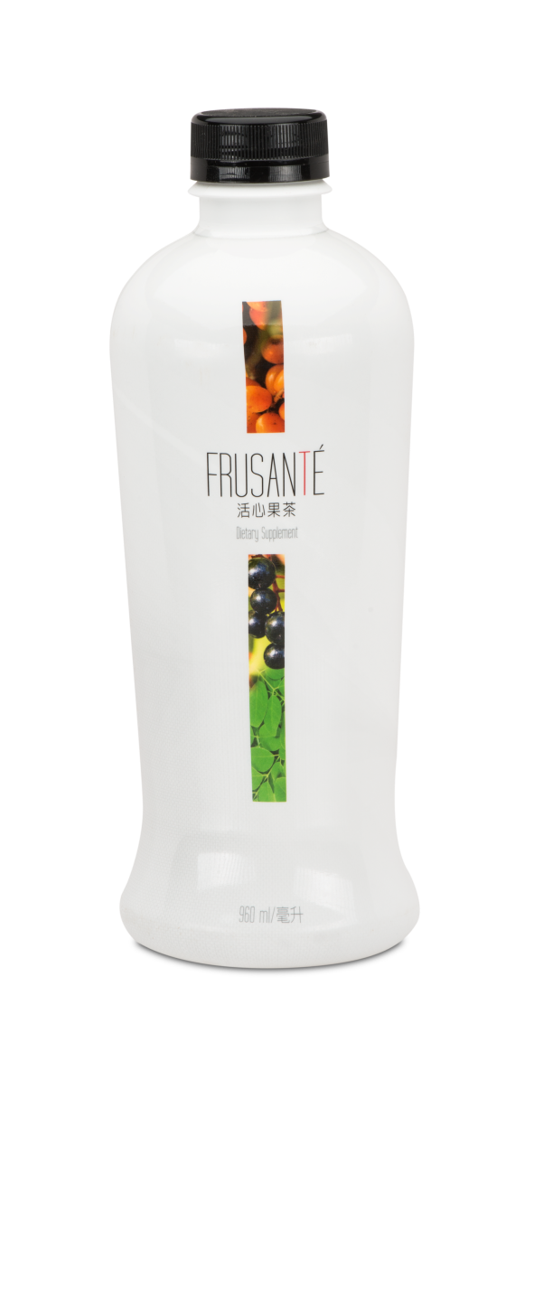
Frusanté 活心果茶
為心臟提供營養，為身體注入能量 Nourish Your Heart, Power Your Body
專有茶葉混合配方 Custom Tea Blend
Photo Credit: Gregory Liu Photography
三種超級水果 Fusion of Three Superfruits
Black Tea: Research has shown that people who drink three or more cups of black tea daily may cut their risk of stroke by 21 percent.
Green Tea: People who drink at least one cup of green tea daily are 42 percent less likely to have a heart attack than those who do not drink green tea.
White Tea: Consumption of white tea resulted in improved glucose tolerance and a reduction in LDL cholesterol.
椰子汁 Coconut Water

Slide 19
Frusanté 活心果茶
為心臟提供營養，為身體注入能量 Nourish Your Heart, Power Your Body
支援心血管健康
支援健康血小板活動及血管正常血流
提供促進整體健康的抗氧化物及植物營養
有助維持人體水分充足
Supports cardiovascular health
Supports healthy platelet activity, supporting normal blood flow through blood vessels
Provides antioxidants and phytonutrients that promote overall good health
Helps keep the body hydrated

Slide 20
Frusanté 活心果茶
為心臟提供營養，為身體注入能量 Nourish Your Heart, Power Your Body
HK12985
DC: HKD$210
SR: HKD$295
BV: 18.50

Slide 21
Frusanté活心果茶市場比較 Frusanté Product Comparison
產品 Products | 水果 Fruits Blend | 混合茶 Tea Blend | 添加糖 Additional Sugar | 食用份量/ 零售價 Servings / Price | 每食用份量 零售價 Price per Serving
Frusanté 活心果茶 | 沙棘、山楸梅、 辣木、椰子汁 Sea Buckthorn, Chokeberry, Moringa, Coconut Water |  |  | 30/ $295 | $9.8
優先沛紅梅 提子汁 Ocean Spray Cran-Grape Juice | 紅葡萄、小紅莓、 山楸梅 Red Grape, Cranberry, Chokeberry |  |  | 2/ $26.9 | $13.5
德國健寶 Rabenhorst | 小紅莓 Cranberry (100%) |  |  | 3.3/ $67.9 | $20.6
光之果 藍莓汁 Sunraysia Blueberry Juice | 藍莓 Blueberry |  |  | 2/ $32.9 | $16.5

Slide 22
資料單張即將推出！
Coming Soon!

